Slide 1



Slide 2


Project Context
The City of Edinburgh Council (CEC)
People’s cycling behaviour
Traffic Density
“a cycling and walking-friendly city”

Slide 3
Data Description
13 counters of 43 counters
Hour-basis count
Counter_id: data collected via labelled counter (1-48)
Date (2015.03.22-2016.06.18)
time: hourly-basis (0~23)
channel_1: the direction of north-bound
channel_2: the direction of south-bound

Slide 4
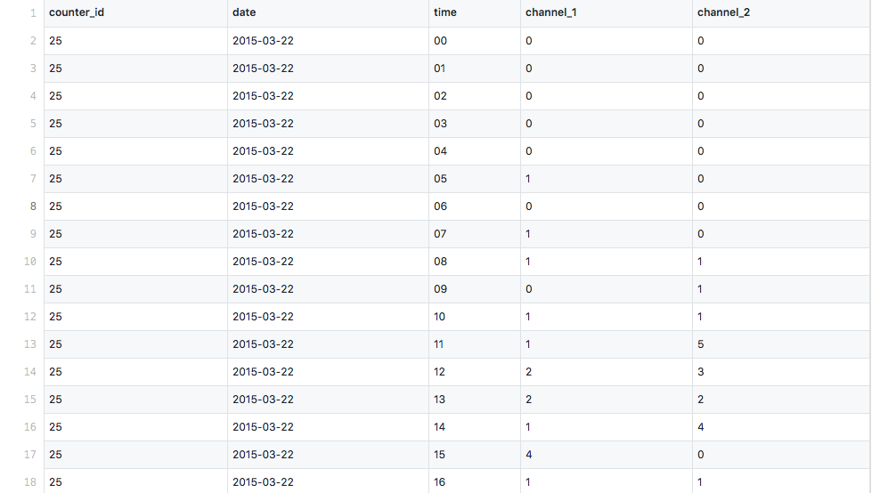

Slide 5
Analysis Description
counter_id date time channel_1 channel_2
Total Traffic
Cycling behaviour
Cycling behaviour

Slide 6
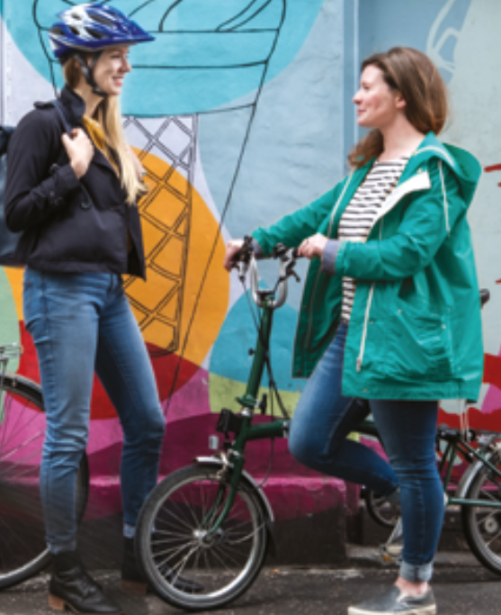
Audience
New comers -> comics
Interested in cycling data -> line chart
Cycling campaign organizer

